Slide 1
Does Titling Matter? Evidence from Housing Markets in India
Antonio Bento, Somik Lall, Joel Landry
2013

Slide 2
Introduction
According to the United Nations (2003), 924 million people or 31.6% of the world’s urban population lives in slums.
Some policy have been proposed to improve the welfare of slum dwellers.
- slum upgrading, expansion of municipal services and infrastructure to slum communities, and providing legal title of property.
This paper attempts to evaluate titling as a strategy for improving the welfare of the urban poor in Pune, India.
Do so by estimating titling into housing value

Slide 3
Background
Pune, India is the second largest City in Maharashtra State
Income is 50% higher than the national average
One of the lowest level of income disparity in India (Pune,2007)
Recent years, they have experienced rapid growth in its industrial, education, and information technology sector. This is followed by population growth of 24% over the last 5 years.
Despite all this, the proportion of slums in Pune is 35.7% which is larger than the world average of 31.6%

Slide 4
Previous Attempts to measure effects of titling on housing values have relied on standard hedonic pricing method through Ordinary Least Square (OLS)
These Studies typically find that titling increases the value of the house by 20%-50% (Jimenez, 1984; Freidman et all, 1988; Lanjouw and Levy, 2002)

Slide 5
Problems with OLS Hedonic
Misspecification of the Functional Form (specification bias)
Other independent variables that might explain the dependent variable
Reliance of observations that are not on the common support (common support bias)
Lack of common support between titled and untitled households on the basis of observable characteristics
Comparing apples to oranges

Slide 6
Author Proposes to use Propensity Score Matching to alleviate the issue
Matching method make no functional form assumption
Only allow comparisons between observations that share a common support
Control housing units that received slum upgrading and better access to services and vice versa

Slide 7
Data and Summary Statistics
Data collected from Pune Household Survey (PHS) between August and October of 2002
PHS contains 2849 random sampled households 430 square km Pune metropolitan area
Of the 2849 households surveyed, 1137 are informal settlements (39.7%)
Rest consists of chawls – modern low rise apartments, bungalows, etc
Of the 1137 informal settlements: 1003 households are squatter settlements or slums and 134 are resettlements
Squatter settlements where the government has agreed to provide basic services are called “notified” slums. These include 903 households

Slide 8
Resettled slum dwellers are involuntarily relocated to new location
The dwelling units of improved quality and design
Of the 903 notified squatter settlements, 789 have been living in their current location for ten years or longer
Of the 134 resettlements, 113 have been living in their current location for ten years or longer
This suggest a de facto or informal tenure security for both groups

Slide 9
Experimental Design
Quasi experimental research design:
Notified squatters form the “untreated” group
Resettlements for the “treated” group
Since resettlement is involuntary, the assignment of the treatment is independent of household and neighborhood characteristics.
Limit sample to resettlements and notified squatters that are owner occupied and have been living in their current location for ten years or longer.
- This provides sufficient time for predicted effects of titling to be translated into housing values
- exclude non-notified squatters and renters, too few observations

Slide 10
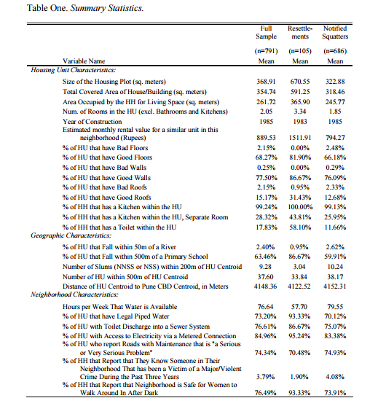

Slide 11
OLS Hedonic
Hedonic estimation provides a natural framework for assessing the impact of a title on housing values
Based on the principle that houses are composite goods whose value is a combination if the values of the individual attributes that compose the house as well as the amenities and services available in the area
Since the effects of titling should be capitalized into housing prices, capture the effect by including a dummy for titling alongside other housing and neighborhood attributes

Slide 12
Uses a Semi-log model
y_{iw}= α + βTitle_{iw} + γX_{iw} + δ_{w} + μ_{iw}
y_{iw} = natual log of the estimated monthly rent value of the housing unit
Title_{iw} = Dummy equal to one if a housing unit possesses a title
X_{iw} = vector of covariates
δ_{w} = Captures the unobservable house invariant fixed effect from residing in a given municipal ward where w= 1…48 different wards
μ_{iw} = Error terms
α, β , γ are the coefficients to be estimated

Slide 13
X_{iw} Includes many of the housing unit, geographic, and neighborhood reported in Table one
Natural log od area used for living space, natural log of the number of hours per week for which water is available, has toilet inside the unit, etc…
y_{iw} The value of the housing unit is the household’s marginal willingness to pay for the vector of swelling unit and neighborhood characteristics that are included on the right hand side of the equation
Title_{iw} is the household’s willingness to pay for a title.

Slide 14
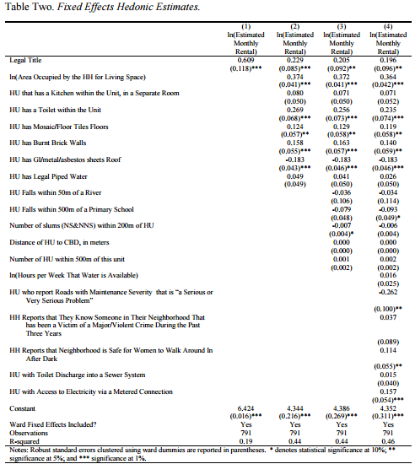

Slide 15
Under the OLS Hedonic specification, a household’s willingness to pay for a title is considerably large
As more covariates are included in the coefficient on titling remains statistically significant
Presence of a title corresponds to a 19.6% increase in the estimated monthly rental value of the housing unit in full model
Smaller than the previous estimates of 58% that Jimenez (1984) finds and closer to 25% shown in Friedman et all (1988)
Smaller due to treatment status being exogenously assigned

Slide 16
Propensity Score Matching
Match treated and untreated observations on the estimated probability of being treated (propensity score)
Enables matching not just at the mean but balances the distribution of observed characteristics across treatment and control
STEPS
Need representative and comparable data for both treatment and comparison groups
Use a logit (or other discrete choice model) to estimate program participations as a function of observable characteristics
Use predicted values from logit to generate propensity score p(x_{i}) for all treatment and comparison group members

Slide 17
PSM: Key Assumptions
Key assumption: participation is independent of outcomes conditional on X_{i}
This is false if there are unobserved outcomes affecting participation
Enables matching not just at the mean but balances the distribution of observed characteristics across treatment and control

Slide 18
Y₁= potential outcome from a housing unit possessing a title
Y₀ = potential outcome from a housing unit without a title
D = 1 → indicate a household that received a title
D = 0 → indicate a household that did not receive a title
The coefficient of interest: the average impact of the treatment on the treated. Which is the mean effect of having received a title relative to an observational equivalent( as measured by X) notified squatter settlement that did not receive a title :Δ^{TT}= E (Y₁ - Y₀|D = 1)
Δ^{TT}= average willingness to pay for a title for the households that actually received a title.
X = vector of observed covariates

Slide 19
Matching method consist of finding a proxy for Y₀(using D=0 data). PSM estimators provide such a proxy by pairing each treated observation with one or more observationally equivalent non treated observations on the basis of the propensity score P(X).
1. Using a probit model to estimate a binary variable for participation (that is whether you receive a title or not) given X.
2. Match observations without a title to observations that have a title on the basis of the propensity score (similar probabilities of receiving a title). Using these matches to non-parametrically estimate a continuous outcome

Slide 20
Estimator has this general form:
E(Y₀|p̂(X_{i}) = Σ^{j}_{j=1} w(p̂(X_{j}), p̂(X_{j}))Y_{0j}
Individual counterfactual for treated observation I, and where j= 1,…,J indexes control group observations.
p̂(X_{i}) is the predicted probability of receiving a title given Xi (the propensity score) for the households that actually received a title (settlements) and p̂(X_{j}) is the predicted probability of receiving a title given Xj for those households that not receive title (notified squatters)
Use Epanechniov kernel to generate weights, w(.)

Slide 21
Kernel Estimator
Deals with common support bias in two ways:
1. Treatment observations that fall off the common support are excluded completely.
2. Assign weights for each untreated observations inversely to the strength of the common support. Smaller the bandwidth, generally the better it deals with these issues. Too small a bandwidth = very few matches is possible. Too large a bandwidth will undermine the identification of the common support problem

Slide 22
Titling and Common Support
From the sample, common support bias is a huge issue in this case
Titled households look very different from non-titled households(captured by X)
Hedonic theory does not suggest functional form
Only some of the notified squatters received slum upgrades and improvements in access to municipal services.
PSM corrects for this by comparing resettlements that have received slum upgrading and improved access to municipal services and infrastructure with notified squatters that have received those improvements as well.
This is important because the effects of titling may vary with the amount of tenure security a household possesses which is itself correlated with observable characteristics

Slide 23
Distribution of Propensity Scores
63% of the untreated group lies below the 5th percentile of the treated group
Mean propensity score of treated observations is 0.42 while the mean for the control observations is 0.14
Relying on a small number of resettlements with decent quality housing and neighborhood characteristics to match with a large number of notified squatters with decent to low quality housing and neighborhood characteristics.
For high values of the probability of participation we are relying on a small number of untreated observations to construct the counterfactual for a large number of treated observations.
Inability to account for weakness of common support condition is what may be driving the findings of a statistically significant effect from titling when conventional hedonic methods are used.

Slide 24
Density
Density of scores
for non-
participants
Density of scores for participants
Region of common support
0
1
High probability of participating given X
Propensity score

Slide 25
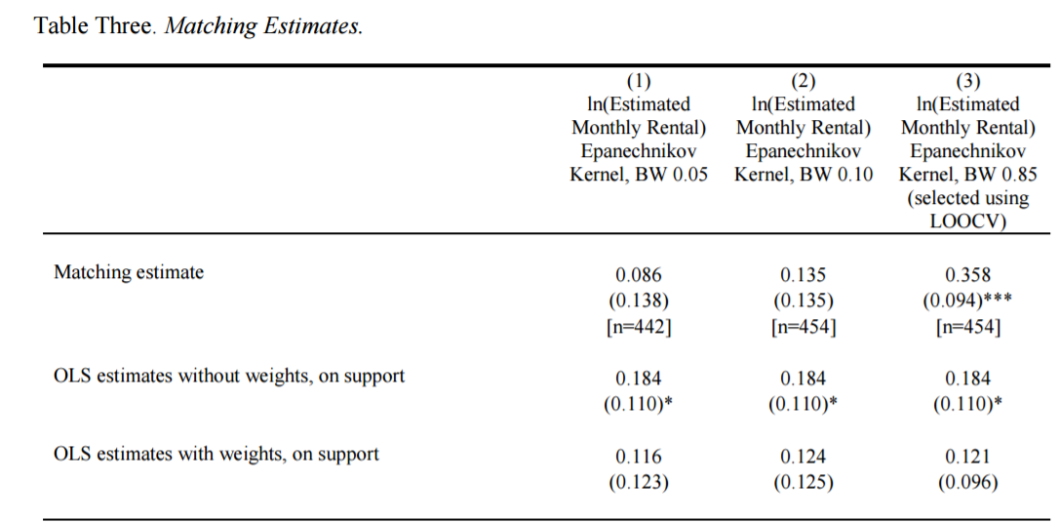

Slide 26
Results
At 0.05 bandwidth, very small willingness to pay for a title of 8.6% of a dwelling unit’s estimated monthly rental value.
Less than half of the 18.4% OLS estimate of 18.4% reported in the second row.
Impact of titling increases from 8.6% in column one to 13.5% in column two when the bandwidth is 0.10. Remains statistically insignificant.
0.10 and 0.85 bandwidth are unreliable due to excessive smoothing bias
Combined increase in variance that arises from specification bias of 0.027, almost twice the size of the increase in variance that arises from specification bias of 0.015.
Shows statistically significant impact from titling under the conventional OLS hedonic results because of its failure to properly account for heterogeneity across common support.

Slide 27
Conclusion
Using Conventional OLS hedonic, we find a statistically significant effect from titling on housing values of 19.6% of the estimated monthly rental value comparable to that found elsewhere in the literature.
Propensity score matching identifies a much smaller impact from titling of only 8.6%. Which is no longer statistically significant.
No effect of titling on property values.
When tenure security is strong and credit markets are weak, then the provision of a formal title has little additional impact on welfare as capitalized into property values.
Formal property rights might be less important than direct targeting of tenure security through other interventions such as slum upgrading and improving access to municipal services and infrastructure.

Slide 28
Criticisms
PSM requires large samples and good data:
Ideally, the same data source is used for participants and non-participants
Participants and non-participants have access to similar institutions and markets, and
The data include X variables capable of identifying program participation and outcomes.
Need good quality data
Common support can be a problem if two groups are very different
Not a complete benefit cost assessment of titling programs or other interventions and so titling may still be the preferred intervention strategy once other welfare impacts are taken into account

